Slide 1
Workbook Data Room
Internal Use Only
April 2017
EXCEL FILE:

Slide 2
Disclaimer
The content of this workbook has been produced by KPMG Germany/Deal Advisory on the basis of German accounting standards and/or IFRS, as well as considering KPMG Germany’s firm and country requirements, regulations, processes, policies and best practices. Please check your local accounting and other requirements before applying the content.

Slide 3
Overview (1/3) – Mission statement
Compiling the Data Room
Flag: Tools referred for costumer analysis such as Excel Interlog etc. are commonly used in German practice. Tools may differ globally.
Mission Statement:
Compile a completely comprehensive data room that contains all the relevant documents and data for a due diligence audit
Customer situation
Definition/Methodology/Tools of the basis analysis
Sell Side/JV/Turnaround
Compilation of extensive information on the company
Assure the confidentiality of selected facts
If necessary, provision of process documents (e.g. financial fact book)
Management of the data room and coordination of the Q&A phase
Cause: Acquisition of company, sale of a minority holding, financing of growth, IPO, joint venture
Refinancing
Scope of data required
Corporate information Protea company overview Business model Protea Competitive position Operations Research and development Organization and human resources Clients and suppliers Legal Insurance Information systems Fixed assets Financial data Tax Environment Other
Methodology
Adjustment of the standardized list of information needs for the company-specific situation
Discussion of the list with the management and/or responsible heads of areas
Selection/Preparation of the documents in a data-room capable format
Reasonable naming, indexing and anonymization of the documents
Tools
Standard information needs list
Data room index – template
K room (for the exchange of larger volumes of data)
Printing company (for scanning of documents)
Provider for virtual data rooms (e.g. Imprima, Merrill, DRS / Drooms, Intralinks)
Degree of standardization
Uniform systematic in structuring capital
Uniform identification and structure of data
Uniform approach in sanitization

Slide 4
Overview (2/3) – Pitfalls
Compiling the Data Room
No. | Pitfalls/Lessons learned
 | Double numbering: Documents are generally automatically numbered when uploaded. Should the documents have been previously numbered a double numbering may occur that must then be removed
 | The renaming of documents should be recorded in a separate document so as to be able classify the documents for the client following a possible renaming.
 | The redacting of documents should be performed in steps so that "temporary redactings“ are saved and subsequent adjustments do not have to be made to the original version
 | Prior to opening the data room for investors a final check of all the documents should be performed and the written release by the clients obtained. This should also contain a check from the legal perspective as well (by attorney of the contracting party)
 | Data-room users generally ask for a print and download release for all documents. With financial investors this tends to be of no essential importance, but caution should prevail, especially with competitors. Any release must be discussed with the seller /management
 | As a rule the information needs list contains lower limits for values in contracts and, correspondingly, only contracts with values above this limit are considered in the data room. This is very relevant for generating SPAs. Here, too, the upper limits are stipulated concerning contracts to be considered. The two values should be identical, otherwise, in the worst case, contracts will not be published in the data room that should have been published according to the SPA
1
2
3
4
5
6

Slide 5
Overview (3/3) – Core issues
Compiling the Data Room
Core Issue | Specific analysis | Page(s)
How are the offers from data room providers obtained and what should be considered in the selection? | Direct telephone query (or via e-mail) with data room providers to obtain offers Generally data about the expected size of (rough number of pages) and duration of the data room Clarification with the client should be invoiced directly with the client or indirectly through KPMG Central aspects in comparison of offers: Fixed costs, variable costs, availability of the service hotline, availability of a Q&A tool, cost of data room DVDs | 6-8
2. What should be considered in preparing the data room? | Requirements for the documents needed on the basis of a comprehensive information requirements list ("IRL") at the target company IRL should be used as a working document and be synchronized with the filing system on the server (i.e. Mark date in IRL and identify file according to date) | 9
What aspects should be considered in the naming of documents? | Precise and uniform naming of the documents Content of the documents should be recognizable on the basis of the name Uniform language (German/English) on the basis of the expected investors Uniform date and time data in the title (e.g. with contracts or financials) | n/a
What aspects should be considered in preparing the documents? | PDF documents: Pages should be turned for the best possible readability Excel documents: Stipulation of the print area and page view Redacting of confidential information and/or information not relevant for the transaction: Names, dates of birth, contact information, banking information, customer information, price/volume data, etc. | n/a
What aspects should be considered in uploading of documents? | Storage of the documents on the KPMG server in the prescribed data-room structure, if applicable analogous to the IRL Numbering and naming of the directories on the KPMG server in accordance with prescribed data-room structure Numbering of the documents is generally performed automatically when uploading (consultation with data-room provider recommended) Performance of the document uploading into the data room either by KPMG or data room provider | n/a
What aspects should be considered in setting up the data room? | Clarification with the client regarding the rights to be provided to data-room users (read/print/download) Set up groups and stipulate rights If needed set up the Q&A tools and corresponding Q&A coordinators and expert groups Use of Excel lists as alternative to the Q&A tool | n/a

Slide 6
Offer overview – Scope of services
Compiling the Data Room
Scope of services
 | Drooms | Imprima | IntraLinks | Merrill Datasite
Service offering | Designated project manager Support with loading of documents as well as indexing | Designated project manager Support with loading of documents as well as indexing | Designated project manager | Designated project manager
Access | Unlimited number of users | Unlimited number of users | 500 users per workspace Additional users: € 665 per 100 users | Unlimited number of users
Security | Security through user identification and encryption Printing and downloading of data can be restricted Personal user accounts | Security through user identification, firewall, virus protection and encryption Printing and downloading of data can be restricted Personal user accounts | Security through user identification, firewall, virus protection and encryption Printing and downloading of data can be restricted Personal user accounts | Security through user identification, firewall, virus protection and encryption Printing and downloading of data can be restricted Personal user accounts
Watermark | Dynamic watermark function | Dynamic watermark function | Dynamic watermark function | Dynamic watermark function
Search function | Full text search | Search and filter function for all types of data | Search and filter function for all types of data | Full text search
Q&A function | Full Q&A platform | Full Q&A platform | Q&A function available Includes auto-delegate function for incoming questions | Full Q&A platform
Service hotline | 24/7/365 | 24/7/365 | 24/7/365 | 24/7/365
Languages | No information | Supports twelve languages | Supports eight languages | Supports eight languages
iPad / iPhone compatibility | Yes | No | Yes | Yes

Slide 7
Offer overview – Price calculation
Compiling the Data Room
Price calculation
 | Drooms | Imprima | IntraLinks | Merrill Datasite
30,000 pages | Base fee: €1,000 (1,500 pages included) Above1,500 pages: €0.42 per page Total cost for 30,000 pages: €12,970 | Base fee: €13,000 (30,000 pages included) Above 30,000 pages: €0.40 per page Total cost for 30,000 pages: €13,000 | Base fee: €9,900 (30,000 pages included) Additional pages: €300 per 1,000 pages (additional pages can be offset against deleted additional pages) Total cost for 30,000 pages: €9,900 | Pages 1 to 9,999: €0.62 per page (every page) Pages 10,000 to 29,999: €0.57 per page (every page) Pages 30,000 to 49,999: €0.53 per page (every page) Above 50,000 pages: €0.49 per page (every page) Total cost for 30,000 pages: €15,900
Offsite scanning | €0.15 per page for A4 or A3 A2 – A0 (black/white): €3.50 per page A2 – A0 (color): €15.90 per page Scan preparation and transport available for extra costs | Sizes up to A3: €0.18 per page A2 – A0 : €4.50 per document | A4: €0.20 per page A3: €0.55 per page A2 – A0: €2.10 per page | Sizes up to A3: €0.19 per page A2 – A0: €5.00 per page
Onsite scanning (at customer’s place) | €0.15 per page for A4 or A3 A2 – A0 (black/white): €3.50 per page A2 – A0 (color): €15.90 per page €25 per hour for preparation €30 per hour for preparation outside of standard time €350 per day for scan mngt. €525 per day for scan mngt. outside of standard time €200 per day for travel expenses (national) | Same as offsite plus €1,750 per day | €42 per hour per person plus travel expenses, accommodation and €500 setup fee | €1,500 per day plus travel expenses, accommodation, and out-of-pocket cost incurred

Slide 8
Offer overview – Operational services
Compiling the Data Room
Operational services
 | Drooms | Imprima | IntraLinks | Merrill Datasite
Additional DVDs, CDs | 3 DVDs included Additional copy: €50 each | 2 DVDs included Additional copy: €0.03 per page per copy, minimum of €250 per copy | 2 DVDs included Additional copy: €200 each Additional Master DVD: €650 each | 2 DVD included Additional copy: €125 each Additional master DVD: €175 each
Extension of data room | Extension of data room (3 months included in price): €0.15 per page from 4th month on (minimum of €250 per month) plus €1 per upload of new page; €0.12 per page from 7th month on (minimum of €250 per month) plus €1 per upload of new page Cost for 3-months extension (30,000 pages): €13,500 | Extension of data room (3 months included in price): 20% of the page rates per 4 weeks Cost for 3-months extension (30,000 pages): Ca. €8,357 (based on 30-day months) | Extension of data room (3 months included in price): Either 1/3 of base rate for monthly extension (automatically) or with small discount for extensions over 3 months (agreement) Cost for 3-months extension (30,000 pages): €9,900 | Extension of the data room (3 months included in price): €0.09 per page charged per month (newly added pages during continuation charged at full rate) Cost for 3-months extension (30,000 pages): €8,100
Extended project management^{(a)} | €150 per hour for extended project management during standard time €200 per hour for extended project management outside of standard time | €150 per hour for extended project management during standard time €1.750 per 8 hour shift for extended project management during weekends (minimum fee) | €175 per hour for extended project management | Free of charge
Misc. | €850 per 8 hour shift for document sourcing (gathering, sorting and scanning) plus travel expenses of €200 per day (national) Data Room freeze / guarantee: €0.23 per page and year (minimum of 36 months) Customized branding of header: €1,500 (one-time) | n/a | n/a | €16 per MB for audio/video/etc.
Note: (a) E.g. splitting of oversize electronic files; extensive re-indexing; reordering or renaming electronic files; extraction of files from other databases; file replacement, etc.

Slide 9
Information needs list as working document
Compiling the Data Room
Index
Topic
Redaction
To be reviewed by
Responsible contact
Document
Received via
Last update
Comments
legal
received
Channel
[Company name]
1
General information
1.1
Provide a brief history of the Company. Include details for all milestone events since founding
[Person]
Partly
In Person
12.4.2013
First meeting in Utrecht (NL) with Person 1, ...
including investments, joint ventures, strategic partnerships, shareholders and management
sequence, main contracts, acquisitions, sales, etc.
>>Please provide company document for Dataroom showing
1.2
Description of the Company’s operations:
[Person]
Yes
In Person
12.4.2013
the history with all relevant milestones, if available
• Details on activities/ contracts
29.4.2013
First meeting in [City]
• Detail on sales process and force, capacities, management
12.06.2013
Various presentations received
• Operational datas
13.06.2013
Contract timeframes received
1.3
Corporate organizational chart
[Person]
Yes
Email
23.4.2013
Organigram VIRN, updates through IM markups
1.4
All documents on the Company and its offer (memo, marketing brochure, commercial presentation,
[Person]
Yes
Email
29.4.2013
Presentation Pohl December 2012
etc.)
02.5.2013
Presentation Oct 2007
1.5
Copies of any reports by any consultants prepared in the last two years (including recent strategic
[Person]
Yes
Email
02.5.2013
Company presentation, April 2009
review report)
22.4.2013
Roland Berger Report from Oct 2007 (old) and 2012 version
1.6
Copies of any available market research reports, industry studies, research reports or news articles
[Person]
Yes
Email
22.4.2013
UNIFE, Roland Berger Rail Market Study 2012 (press
on the Company or its industry or its underlying markets
conference presentation)
2
CORPORATE DOCUMENTS
2.1
Group Legal Structure
2.1.1
Group legal structure (in context of Company's organization) indicating name of the company, registered
Yes
Yes
Email
23.4.2013
Commercial Register Excerpt
seat, share capital amount
2.2
Charter documents
2.2.1
By-laws/ Articles of association
Yes
Yes
Email
23.4.2013
Articles of association
2.2.2
Commercial register excerpts (as per today and any historic changes)
Yes
Yes
Email
23.04.2013
Commercial register excerpt (27.09.2011) (Dutch)
2.2.3
Internal company rules (Guidelines, code of conducts etc.)
Yes
Yes
Email
13.06.2013
11.4.2013
- Corporate planning handbook for Company's companies
23.4.2013
- Code of conduct (German and Dutch)
23.4.2013
- VIRN Rules of procedure (BoM)
23.4.2013
- VIRN Rules of procedure (Advisory Board)
2.2.4
Notarial deed of incorporation
Yes
Yes
Email
13.6.2013
- Company Terms and Conditions
2.2.5
Registration statement of the Company with the appropriate authorities
Yes
Yes
Email
23.4.2013
Articles of association
2.2.6
Profit Transfer Agreement currently in place
Yes
Yes
13.6.2013
Registration at the chamber of commerce
2.2.7
List
of
all
jurisdictions
in
which
company
is
qualified
to
do
business.
If
the
companies
do
business
Yes
Yes
Email
13.6.2013
No restrictions to do business outside NL
outside
of
their
country,
a
copy
of
all
relevant
regulatory
approvals
authorizing
the
establishment
and
maintenance of such offices

Slide 10
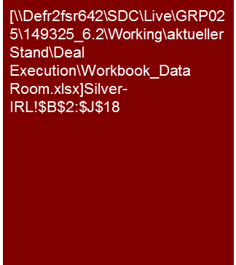
Info request list – 1. Business overview and strategy
Compiling the Data Room

Slide 11
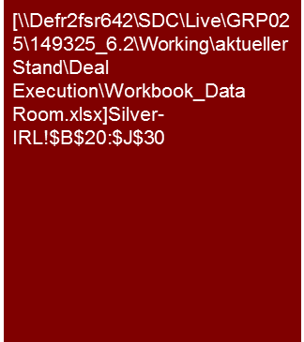
Info request list – 2. Legal (1/2)
Compiling the Data Room

Slide 12

Info request list – 2. Legal (2/2)
Compiling the Data Room

Slide 13

Info request list – 3. Financial information (1/2)
Compiling the Data Room

Slide 14

Info request list – 3. Financial information (2/2)
Compiling the Data Room

Slide 15
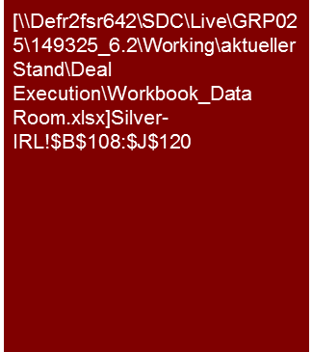
Info request list – 4. Competitive position (1/2)
Compiling the Data Room

Slide 16

Info request list – 4. Competitive position (2/2)
Compiling the Data Room

Slide 17
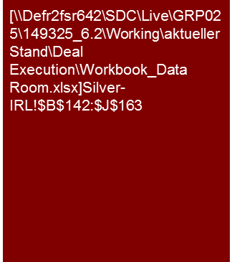
Info request list – 5. Costumer relationships (1/2)
Compiling the Data Room

Slide 18

Info request list – 5. Costumer relationships (2/2)
Compiling the Data Room

Slide 19
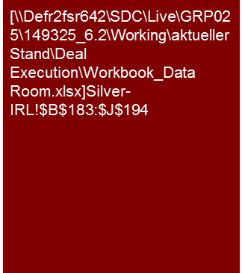
Info request list – 6. Debt financing
Compiling the Data Room

Slide 20
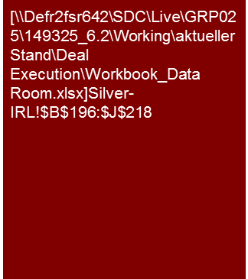
Info request list – 7. Human resources (1/2)
Compiling the Data Room

Slide 21
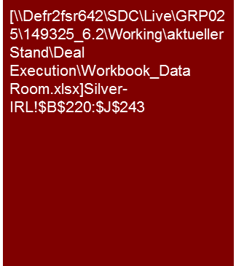
Info request list – 7. Human resources (2/2)
Compiling the Data Room

Slide 22
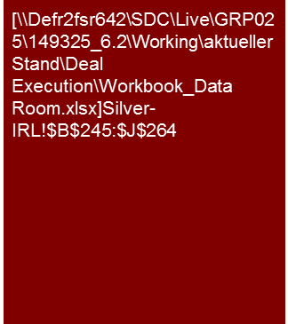
Info request list – 8. Supplier relationships
Compiling the Data Room

Slide 23

Info request list – 8. Production and distribution (1/2)
Compiling the Data Room

Slide 24
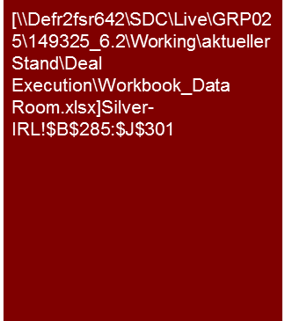
Info request list – 8. Production and distribution (2/2)
Compiling the Data Room

Slide 25

Info request list – 10. Environmental aspects
Compiling the Data Room

Slide 26
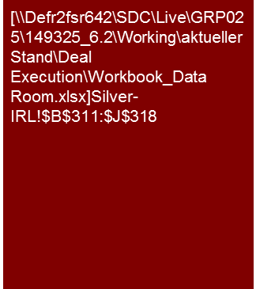
Info request list – 11. License
Compiling the Data Room

Slide 27
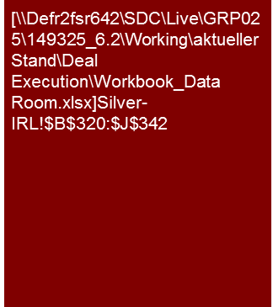
Info request list – 12. Tax (1/2)
Compiling the Data Room

Slide 28

Info request list – 12. Tax (2/2)
Compiling the Data Room

Slide 29

Info request list – 13. Business process
Compiling the Data Room

Slide 30

Info request list – 14. Business structure
Compiling the Data Room

Slide 31

Info request list – 15. Financial forecasts
Compiling the Data Room

Slide 32

Info request list – 16. Other
Compiling the Data Room

Slide 33
© 2017 KPMG International Cooperative (“KPMG International”). KPMG International provides no client services and is a Swiss entity with which the independent member firms of the KPMG network are affiliated.

